Slide 1
Introduction to Basic Statistics and Probability Theory

Slide 2
Probability
Sample space or population: Set of all possible outcomes.
Probability: Let A be an event in a sample space. By P(A), the probability of the event A, we mean the proportion of times the event A will occur in repeated trials of an experiment.
Properties of Probability. P(A) is a real-valued function and has these properties:
1. 0 ≤ P(A) ≤ 1 for every A.
2. If A, B, C, . . . constitute an exhaustive set of events, then P(A + B+C +· · ·) = 1, where A + B + C means A or B or C, and so forth.
3. If A, B, C, . . . are mutually exclusive events, then
P(A + B + C + ·· ·) = P(A) + P(B) + P(C)+· · ·

Slide 3
Random variable
A variable whose value is determined by the outcome of a chance experiment is called a random variable (rv).
A random variable may be either discrete or continuous. A discrete rv takes on only a finite (or countably infinite) number of values.
For example, in throwing two dice, each numbered 1 to 6, if we define the random variable X as the sum of the numbers showing on the dice, then X will take one of these values: 2, 3, 4, 5, 6, 7, 8, 9, 10, 11, or 12.
A continuous rv, on the other hand, is one that can take on any value in some interval of values. Thus, the height of an individual.

Slide 4
Probability density function
If X is a continuous random variable. Then f(x) is the probability density function if:
The last equation basically describes the probability of the random variable being between two discrete points.
E.g., the probability of stock returns tomorrow for AAPL being between 10% and 15%

Slide 5
PDF – normal distribution
WAP to plot a normal distribution in Python using numpy, stats, and matplotlib. Use mean of 8 and sd of 2.

Slide 6
Cumulative density function
CDF of any distribution f(x) at a point a is the sum of all probabilities up to point a.
Implement a normal CDF function in Python

Slide 7
Random variables can be correlated with each other
Key concept in finance
The value of portfolio diversification increases when assets move less together, i.e. have lower correlation.
The best hedges have negative correlation.
First, we need to understand the concept of joint and conditional distributions.

Slide 8
Conditional and marginal probability distribution
Joint Probability Density Functions
Discrete Joint PDF (we will focus on this since math is simpler)
Let X and Y be two discrete random variables. Then
the function
f (x, y) = P(X = x and Y = y)
= 0 when X = x and Y = y
is known as the discrete joint probability density function and gives the (joint) probability that X takes the value of x and Y takes the value of y.

Slide 9
Example
The following table gives the joint PDF of the discrete variables X and Y.
This table tells us that the probability that X takes the value of −2 while Y simultaneously takes the value of 3 is 0.27 and that the probability that X takes the value of 3 while Y takes the value of 6 is 0.35, and so on.
An intuitive way to think about this is Y may reflect state of the economy, and X reflects payoffs on a bond. Clearly the worse the economy, the lower the likely payoff on the bond.

Slide 10
Marginal Probability Density Function
In relation to f (x, y), f (x) and f (y) are called individual, or marginal, probability density functions.
Calculate the marginal PDF of y=3 and y=6 in the example above.

Slide 11
Conditional PDF and statistical independence
In regression analysis we are often interested in studying the behavior of one variable conditional upon the values of another variable(s). This can be done by considering the conditional PDF. The function
f (x | y) = P(X = x | Y = y)
is known as the conditional PDF of X; it gives the probability that X takes on the value of x given that Y has assumed the value y.
Similarly, f (y | x) = P(Y = y | X = x)
The conditional PDFs may be obtained as the ratio of joint distribution to marginal distribution:
f (x | y) = f (x, y)/f (y)
f (y | x) = f (x, y)/f (x)
Statistical independence means:
f (x, y) = f (x) f (y)

Slide 12
Expectation and variance
We often like to describe distribution by their characteristics. These include, the weighted average middle of the distribution and the spread. The best way to look at these numbers is using expected value and variance, respectively.
Expected value: The expected value of a discrete rv X, denoted by E(X), is defined as follows:
For a sample, the expected value is estimated by the mean.

Slide 13
Variance
Measures the spread of the random variable around the mean. Assume the mean is mu. Then, variance:
σ (Sigma) refers to square root of variance and is called standard deviation.
Ex: WAP to calculate the mean and variance of x and y variables in the previous example. Set the program up as a function that takes values of the random variable and the probability distribution as arrays, which returns mean and variance.

Slide 14
Covariance and correlation – both measure how two values move together
Covariance: Let X and Y be two rv’s with means μ_{x} and μ_{y}, respectively. Then the covariance between the two variables is defined as
Correlation: The (population) correlation coefficient ρ (rho) is defined as:
Correlation is a measure of linear

Slide 15
Correlation and diversification
E(X + Y) = E(X) + E(Y)
var(X + Y) = var (X) + var (Y) + 2 cov (X, Y) = σ²_{x} + σ²_{y} + 2ρσ_{x}σ_{y}
Now suppose you have w1 invested in stock X and w2 invested in stock Y.
E(w1.X + w2.Y) = w1.E(X) + w2.E(Y)
var(w1.X + w2.Y) = w1². σ²_{x} + w2². σ²_{y} + 2w1..w2.ρσ_{x}σ_{y}
Ex: Assume E(X)= 15%, E(Y)= 10%, σ_{x} =0.12, σ_{y} =0.16, ρ = 0.67
WAP to calculate the lowest variance combination of two assets – portfolio optimization.
Show the allocation frontier in a scatter plot, identifying:
The lowest variance portfolio
The efficient frontier

Slide 16
Distributions
Normal distribution: A (continuous) random variable X is said to be normally distributed if its PDF has the following form:
where μ and σ, known as the parameters of the distribution, are, respectively,
the mean and the standard deviation of the distribution. The properties of this distribution are as follows:
1. It is symmetrical around its mean value.
2. Approximately 68 percent of the area under the normal curve lies between the values of μ ± σ , about 95 percent of the area lies between μ ± 2σ , and about 99.7 percent of the area lies between μ ± 3σ .

Slide 17
By convention, we denote a normally distributed variable as
X ∼ N(μ, σ²)
where ∼ means “distributed as,” N stands for the normal distribution, and the quantities in the parentheses are the two parameters of the normal distribution, namely, the mean and the variance.
A “Standard normal” distribution refers to random variable with μ =0 and σ²

Slide 18
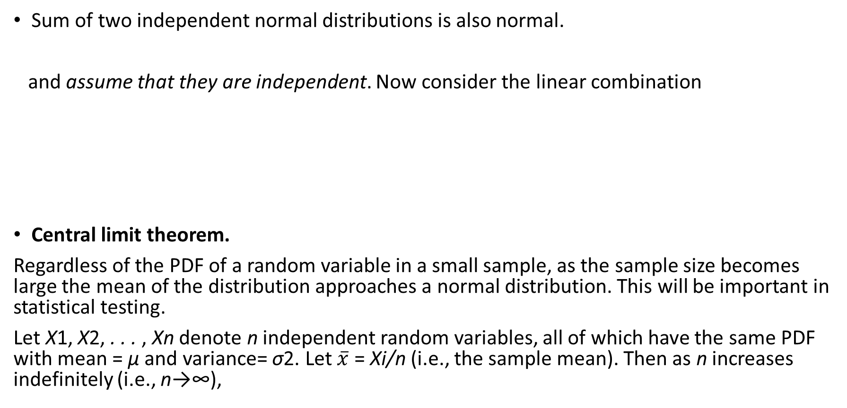
Some other features of normal distributions

Slide 19
Statistical inference: estimation and hypothesis testing
Statistical inference is essentially assessing the possibility that your analysis yields an estimate that is precise enough.
Why? You are almost always estimating using a sample, and not the population. Which means you cannot be sure whether your estimate is signal or noise!
As an example, the average you estimate from a sample of a random variable, may not be the same as the average of that value in the population.
Average price of gas in the US is $3.
If you measure average price of gas in CA, which is $5, it is quite different from the national average, and cannot be a representation of the national average.
What if you did not know the national average, and you are trying to assess whether your sample from is a good representation of the national average?
What if there was a way of determining that your gas price average estimate is not the same as the national average. That is, rule out the hypothesis that your gas price average estimate is not the same as the national average.

Slide 20
How to think about hypothesis testing
Ruling out one hypothesis in favor of another.
So, we can not test for the true national average, but we can test whether your gas price average is statistically close to a hypothesized value, say $6.
Let’s test the hypothesis that the gas prices sample you have comes from a population whose mean is $6.
In the language of hypothesis testing,
Gas price average = 6 is called the null (or maintained) hypothesis. Denoted by H_{0.}
Gas price average ≠6 is called the alternative hypothesis. Denoted by H₁

Slide 21
Suppose you know that gas prices follow a normal distribution with variance σ.
Gas_price_mean ∼ N(μ, σ²/n),
where, n is sample size
If we standardize our mean value by subtracting μ and dividing by σ/, we should get a standard normal distribution:
Z = ∼ N(0, 1), This is called the test statistic
Now, we know that Pr (−1.96 ≤ Zi ≤ 1.96) = 0.95.
Remember this figure?
So the null hypothesis is not violated with 95% (i.e., high) probability only if Z falls between these values. If not?
Then, we can say that the math/probabilities did not add up for our sample to come from a sample with a mean of 6.
So you REJECT the null hypothesis in favor of the alternative, which is that average gas price is not 6.

Slide 22
Rejecting one number for another should not make you care much. So why do statisticians care?
Because there is one number which everyone wants to compare their estimates to - ???
What would it mean that your regression coefficient was statistically different from 0 with 95% probability?
That there is an effect!
Confidence interval: Pr (−1.96 ≤ Zi ≤ 1.96) = 0.
Calculate this 95% confidence interval for µ= 6, σ= 3, and n=100. X-bar = 4
What do you infer about the distribution your sample comes from?
What would you infer if µ=0?

Slide 23
So we want to reduce the false null reject likelihood of a correct null hypothesis as much as possible
This is called the type I error, which we look to minimize.
If we use the 95% confidence interval, the chance of wrongly rejecting the null is 1-95% = 5%. Economists prefer to use 5% or lower chance of a type I error. The 5% or the α, as it is known more commonly known is called the level of significance.
This is because we are usually rejecting the null that our estimate is 0, and that implies finding an effect. We would rather not find an effect at the expense of missing a significant effect if there was one.
The p Value, or Exact Level of Significance: Instead of preselecting α at arbitrary levels, such as 1, 5, or 10 percent, one can obtain the p (probability) value, or exact level of significance of a test statistic. The p value is defined as the lowest significance level at which a null hypothesis can be rejected. We will prefer p-values lower than 5%.

Slide 24
Warning
Not rejecting the null hypothesis does NOT mean you are accepting it!
All you can say is that the null is not rejected. Because the type II error probability is 95% (probability of accepting a false null), you are unable to say anything at this point about the estimate.

Slide 25
Assessing statistical significance of a sample mean
WAP to:
Bring in the Apple stock ticker (AAPL) using pandas_datareader using
aapl = pdr.get_data_yahoo('AAPL',
start=datetime.datetime(2006, 10, 1),
end=datetime.datetime(2012, 1, 1))
Using the t-test, Test the hypothesis that the mean daily stock returns of AAPL is statistically significantly different from:
0%
1%
0.1%
0.001%

